Slide 1
Winter Safety
Project First Aid: Module 6
Camelia and Kim
Notes:
https://newsnetwork.mayoclinic.org/discussion/smart-decisions-and-preparation-lead-to-better-winter-health/
Camelia
Hi, module 6 is on winter safety! If you have any questions, please feel free to raise your hand and ask at any time!

Slide 2
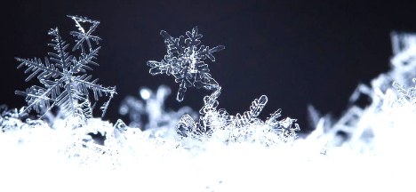
What We’ll Cover Today
Hypothermia
Symptoms
Causes
Treatment
Prevention
Frostbite
Symptoms
Causes
Treatment
Prevention
Driving in the Snow
Staying Warm
Winter First Aid Kit
Notes:
Kim
Today, we will be talking about the symptoms, causes, treatment, and prevention of hypothermia and frostbite.
We will also cover some basic winter safety tips.

Slide 3
What is Hypothermia?
Hypothermia occurs when your body temperature falls below 95° F or 35°C
Normal body temperature is around 98.6°F or 37°C
When your body temperature drops, different parts of your body cannot work normally. This could cause your heart and lungs to fail, leading to death. It also impairs your brain, leading to confusion.
Usually caused by being outside in cold weather or being in cold water for too long
Notes:
Camelia
What is hypothermia?
Hypothermia occurs when your body temperature falls below 95 degrees fahrenheit or 35 degrees celsius.
Our normal body temperature is around 98.6 degrees fahrenheit or 37 degrees celsius.
For a typical adult, body temperature can be anywhere from 97°F to 99°F. Babies and children have a little higher range; it lies between 97.9°F to 100.4°F.
When your body temperature drops, different parts of your body cannot work normally.
This could cause your heart and lungs to fail, leading to death.
It also impairs your brain which leads to confusion.
Hypothermia is typically caused by being outside in cold weather or being in cold water for too long.

Slide 4
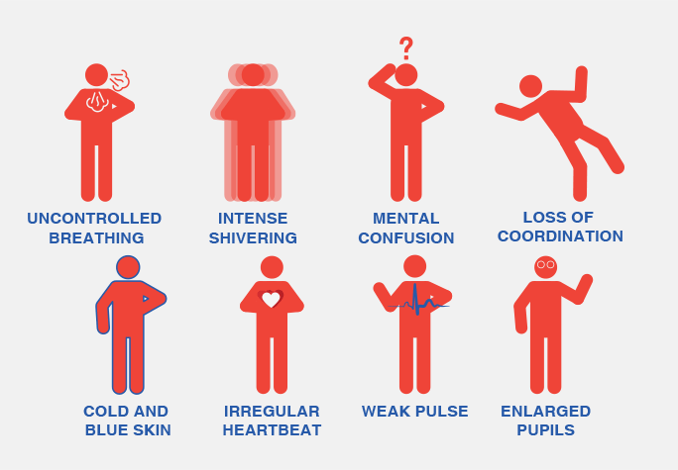
Symptoms of Hypothermia
Shivering
Slurred speech/ mumbling
Shallow breathing
Weak pulse
Lack of coordination
Drowsiness/ low energy
Confusion
Loss of consciousness
Bright red, cold skin
Notes:
Kim:
The symptoms of hypothermia include shivering, slurred speech, shallow breathing, a weak pulse, lack of coordination or clumsiness, drowsiness, confusion, loss of consciousness and bright red, cold skin.
As the temperature starts to drop, you start to shiver because it’s your body’s automatic defense against cold temperature.
Someone who has hypothermia usually doesn’t know their condition because the symptoms begin gradually.
In addition, the confusion that occurs during hypothermia prevents self-awareness.

Slide 5
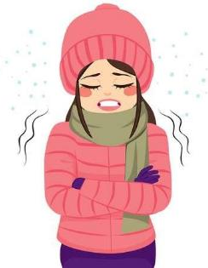
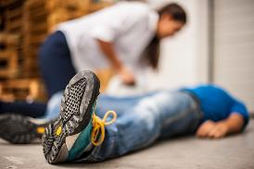
Stages of Hypothermia
Stage 1
Shivering, reduced circulation
Stage 2
Weak pulse, slowed breathing, lack of coordination, confusion, drowsiness
Stage 3
Weak or absent respiration and pulse, loss of consciousness
Notes:
Camelia
There are 3 stages of hypothermia.
During stage 1 of hypothermia, the symptoms include shivering and reduced circulation.
During stage 2 of hypothermia, the symptoms include a weak pulse, slowed breathing, lack of coordination, confusion, and drowsiness.
The third stage of hypothermia is severe. There may be a weak or absent pulse and loss of consciousness.

Slide 6
Hypothermia Treatment
Call 911 immediately: You must seek emergency help for hypothermia!
While waiting for emergency help,
Gently move the person inside
Remove their wet clothing
Cover them with warm, dry clothes or blankets
Notes:
Kim
If you suspect someone has hypothermia, call 911 immediately!
While you are waiting for emergency help to arrive, gently and carefully move the person inside if possible. Make sure to not move them roughly as this may cause dangerous irregular heartbeats. Carefully remove his or her wet clothing and replace it with warm, dry coats or blankets.

Slide 7
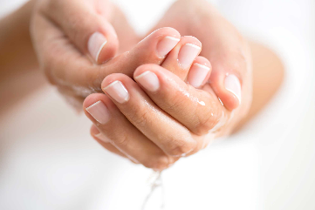
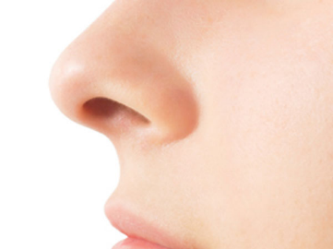
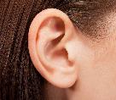
What is Frostbite?
Frostbite occurs when skin is exposed to the cold over a long period of time and the tissues below the skin freeze
It can affect any part of the body
However, the most commonly affected areas are the hands, feet, ears, and nose. These are the areas that are most likely to be exposed to the cold when you’re outside.
Notes:
Camelia
What is frostbite?
Frostbite occurs when skin is exposed to the cold over a long period of time and the tissues below the skin freeze.
Frostbite can affect any part of the body.
However, the most commonly affected areas are the hands, feet, ears, and nose.
These are also the areas that are most likely to be exposed to the cold when you’re outside.

Slide 8
Symptoms of Frostbite
Frostbite symptoms begin when the affected area begins to turn red and feel painful
If exposure to the cold continues, you may feel the sensation of ‘pins and needles’ in the area
Then the area will turn numb as the tissues freeze
Skin will become white, blue, or blotchy as exposure to cold continues
Notes:
Kim
Frostbite symptoms begin when you’re outside and the affected area begins to turn red and feel painful
If exposure to the cold continues, you will feel the sensation of ‘pins and needles’ in the area
As the tissues freeze, the area will turn numb
Your skin will become white, blue, or blotchy as exposure to cold continues

Slide 9
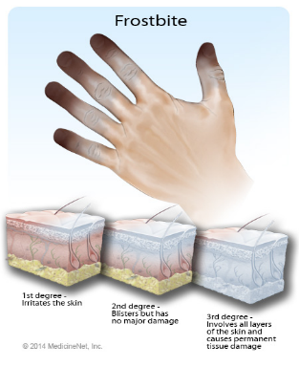
Degrees of Frostbite
First-degree (Frostnip): Irritates the skin, but is not serious and the damage does not last. It may cause some pain as the skin warms again
Second-degree: Causes blisters and deeper tissue damage. Does not cause permanent damage
Third-degree: Damages all layers of the skin, which turns black. Damage is permanent. In very severe cases, bone and tendon freeze as well
Notes:
Camelia:
There are 3 degrees of frostbite.
The first degree also known as frostnip irritates the skin, but is not serious and the damage does not last. It may cause some pain as the skin warms again.
The second degree of frostbite causes blisters and deeper tissue damage. The damage is not permanent.
The third degree of frostbite damages ALL layers of the skin, which turns black. The damage is permanent. In very severe cases, bond and tendon freeze as well.

Slide 10
Important Note
When you’re out in the cold, you may think that no damage is occurring
The skin must be rewarmed before the degree of frostbite can be known
While outside, the skin will not blister or turn black. This will only occur after the skin is rewarmed
For this reason, it’s extremely important to avoid exposure to cold for a long time
Notes:
Kim
This is something very important to keep in mind
When you’re out in the cold, you may think that no damage is occurring
This is because the skin must be rewarmed before the degree of frostbite can be known
When you’re outside, the skin will not blister or turn black. This will occur after the skin is rewarmed
For this reason, it’s extremely important to avoid exposure to cold for a long time

Slide 11
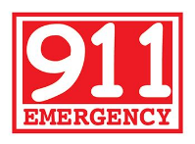
Frostbite Treatment
First, call for emergency medical care!
Treatment depends on how severe the frostbite is
It is best if a medical professional is available to handle the care, because they will know what stage it is and what to do for each
Notes:
Camelia
To treat frostbite, first call for emergency medical care!
The treatment will depend on how severe the frostbite is.
It is best if a medical professional is available to handle the care as they will know what stage of frostbite the patient has and how to treat that stage of frostbite.

Slide 12
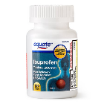
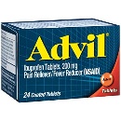
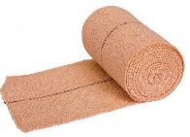
Frostbite Treatment
If there is no medical care available, or you have to wait for care, some steps can be taken:
Take ibuprofen
Rewarm the area by soaking the area in warm (but not hot) water
Do this for 30 minutes, or until the area is red-purple colored and can be moved easily
After the area has been warmed, wrap the area in clean bandages (if it’s the hands or feet, wrap each finger or toe separately)
Avoid contact with the area
Notes:
Kim

Slide 13
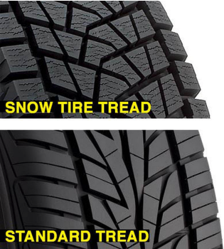
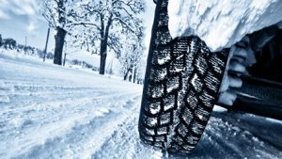
Driving in the Snow
Drive slowly
Accelerating, stopping, and turning all take more time than it does on dry pavement.
Snow tires
Notes:
Camelia
If you’re driving on snow- covered roads, please drive slowly and give yourself time.
Applying the gas slowly to accelerate will help you regain traction and avoid skids, especially on icy roads.
Take time to slow down for a stoplight. It takes longer to stop on icy roads and it is much safer to step on the brake earlier.
If you’re driving a lot early in the morning or late at night, it may be a good idea to consider snow tires which have better traction.

Slide 14
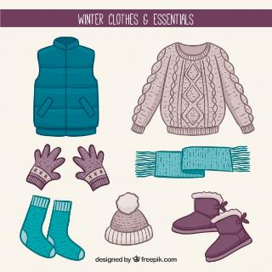
General Winter Safety Tips
Avoid long exposure to cold weather
Dress in layers of clothing
Protect the feet, hands, head, ears, and nose from extreme low temperatures
Stay well hydrated if you are spending time outdoors
Sit and stand in positions that allow for proper circulation
Be careful of drinking alcohol; your body will not be able to warn you as well if you are cold.
Notes:
Kim

Slide 15
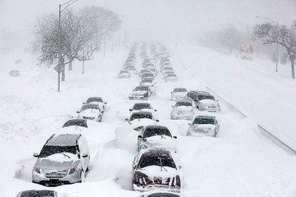
Winter Survival Kit
Water
Blankets
Flashlights/ Flares
Shovel
Power Source
Food
Tool Kit
First Aid Kit
Toiletries
Notes:
Camelia and Kim
Camelia
In a cold state with extreme winters like Minnesota, it’s important to keep a winter survival kit in your car. Your winter survival kit should include the following: water, blankets, flashlights/ flares, a shovel, a power source, food, a tool kit, a first aid kit, and some toiletries.
If you’re stranded somewhere or snowed in, it’s important to stay hydrated. You should keep water in the car and not in the trunk of the car to prevent the water from freezing.
In addition to staying hydrated, you’ll need to stay warm. You should include blankets and extra warm clothes in your survival kit.
Flashlights will be helpful if winter weather causes a power outage and flares can be used as a signal for help.
If you’re snowed in, the shovel can be used to dig yourself out.
The power source could be a backup battery to charge your phone in case of emergencies.
Kim
You should also include food in your survival kit so that you’ll have something to eat if you’re stranded. Good foods to include in your kit would be granola bars, nuts, and dried fruits. These are all items that will last a long time.
You should also keep a well stocked first aid kit with necessary medications. The basic first aid kit can be purchased at Target, Walmart, and many other stores.
It would be good to have tissues and plastic bags in your car to help you stay comfortable when you’re snowed in.
It’s important to place your winter survival kit in an easily accessible place such as the backseat of your car. If you are snowed in, you may not be able to get out of the car and open your trunk.

Slide 16
Vocabulary
Hypothermia
Shivering
Shallow
Gradually
Exposure
Circulation
Stranded
Extreme
Pavement
Coordination
Notes:
Please discuss what you think these words mean with the people around you. In 5 minutes, we will go over these words together as a class. During this time, you can also ask us any questions you may have.
Hypothermia: occurs when your body temperature falls below 95 degrees Fahrenheit or 35 degrees Celsius
Shivering: shaking slightly or uncontrollably from the cold
Shallow: not deep, near the surface
Gradually: slowly
Exposure: contact with something
Circulation: movement of fluid, usually movement of blood in your body
Stranded: stuck somewhere
Extreme: severe, serious
Pavement: sidewalk, road
Coordination: proper balance and ability to move body the way you want to

